Slide 1
CPE 133
Number Systems Conversions
Useful Codes
Digital Design Problem

Slide 2
Important Information
Friday: the first lab
Laptop users:
download Xilinx Vivado 18.2 WebPack
Not enough benches for everyone
The course in general
Starts slow picks up when labs start
When labs start, you’re learning digital design and Verilog simultaneously
Don’t let the initial slow pace fool you

Slide 3
Number Systems Conversions
Any radix to decimal
1011.11₂ to decimal
4AF.2D₁₆ to decimal
Binary ↔ Hexadecimal
11000101001.11001₂ to hexadecimal
3AF8.2D₁₆ to binary

Slide 4
“Binary” Multiplication & Division
Multiply 23A.47₁₆ by 256
Divide DEAD.BEEF₁₆ by 16
Multiply 10011101.11₂ by 32
Divide 100011.1101₂ by 16

Slide 5
Useful Codes
Binary Coded Decimal (BCD)
367 to BCD
001101101001_{BCD} to decimal
One-hot codes
Number of bits = number of codewords
Only one bit set in each codeword
Unit Distance Codes
Distance: quantity of bits you need to change to go from one codeword to another codeword
Often referred to as “gray codes”

Slide 6
Digital Design and Modeling
Digital design two main qualities:
Modular
Hierarchical
Definition 1: A representation of something
Definition 2: A description of something in terms that highlights the relevant information while hiding the less useful information
Purpose: transfers information to the entity reading the model
Comments:
No absolutely “correct” model

Slide 7
Digital Design Description
An approach to digital design:
Define the problem: understand the starting point and requirements
Describe your solution to the problem: propose your path to the solution
Implement your solution to the problem: embodiment of the solution
Main Design approaches:
BFD – brute force design (iterative design)
IMD – iterative modular design
MD – modular design

Slide 8
Digital Design Description
Example: Problem Statement - Design a digital circuit where the output of the circuit indicates when the 3-bit binary number on the input is greater than four. State how your circuit is controlled.
A typical design approach:
Define the problem: understand the starting point and requirements
Describe your solution to the problem: propose a path to the solution
Implement your solution to the problem: embodiment of the solution

Slide 9
The First Steps in Solution
Define the high-level interface: draw a high-level black box diagram (BBD)
box has name
inputs and outputs clearly marked
annotations clarify the diagram
Design on design approach
brute force design (BFD)

Slide 10
Step 1: Define the Problem
The BFD thing

Slide 11
Step 2: Describe your Solution
Algebra: a mathematical system used to generalize arithmetic operations by using letter or symbols to stand for numbers based on rules derived from a minimal set of basic assumptions
Axioms: a set of basic assumptions that are universally accepted as true.
Theorems: propositions that can be proved true using basic axioms
George Boole: created a two-valued algebra (Boolean Algebra)
Based on a set of operators defined over a set of elements in question.
Elements are: {0,1}
Operators are: defined by axioms

Slide 12
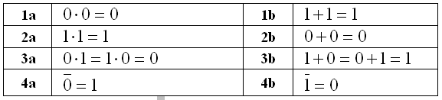
Basic Axioms of Boolean Algebra
operators and numbers…

Slide 13

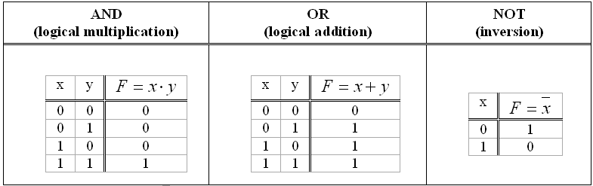
Basic Boolean Algebra Operators
Truth tables for basic logic functions

Slide 14
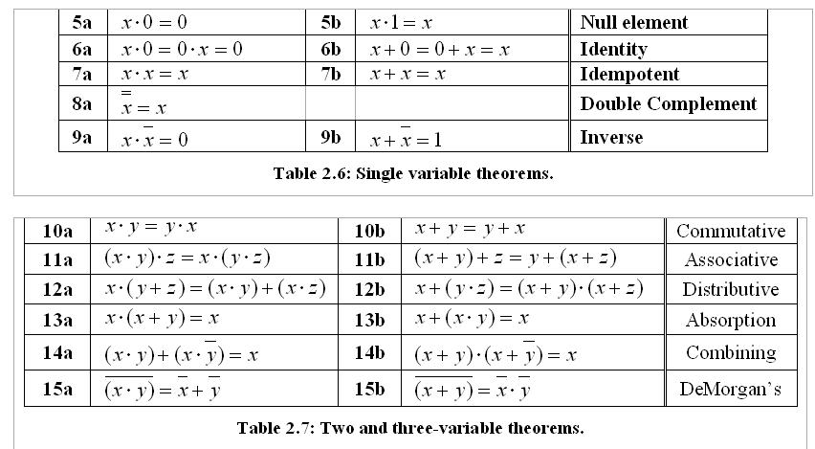
Boolean Algebra Theorems

Slide 15
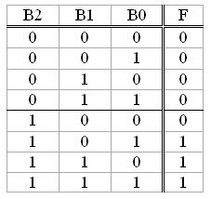

Three Solution Descriptions
Tabular Description:
Truth Table
Written Description
Boolean Algebra Description

Slide 16
Step 3: Implement your Solution
Pretend you’re really going to build this circuit…

Slide 17
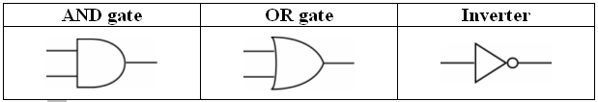
Basic Boolean Operators and Gates
Gates: Implement basic Logic Functions

Slide 18
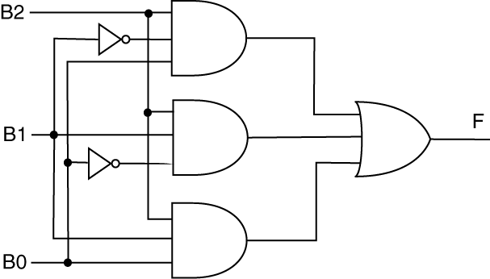
The Circuit Solution
Create circuit by using gates to represent logic operations
Boolean Algebra Description
Circuit Model of Solution

Slide 19
Four Equivalent Solution Descriptions
Circuit Description
Tabular Description
Written Description
Boolean Algebra Description

Slide 20
Example Problem
Design a circuit whose 3-bit output is two greater than the 3-bit input. Outputs that exceed the 3-bit range should be set to zero.
Provide Boolean equations describing output
Provide circuit diagram using AND gates, OR gates, and inverters

Slide 21
Example Problem
Write a Boolean equation describing the following circuit.

